Slide 1
WomenTechWomenYes : Summer Gala Fundraising Strategy
A project executed by Metis Consulting LLC
July 2019

Slide 2
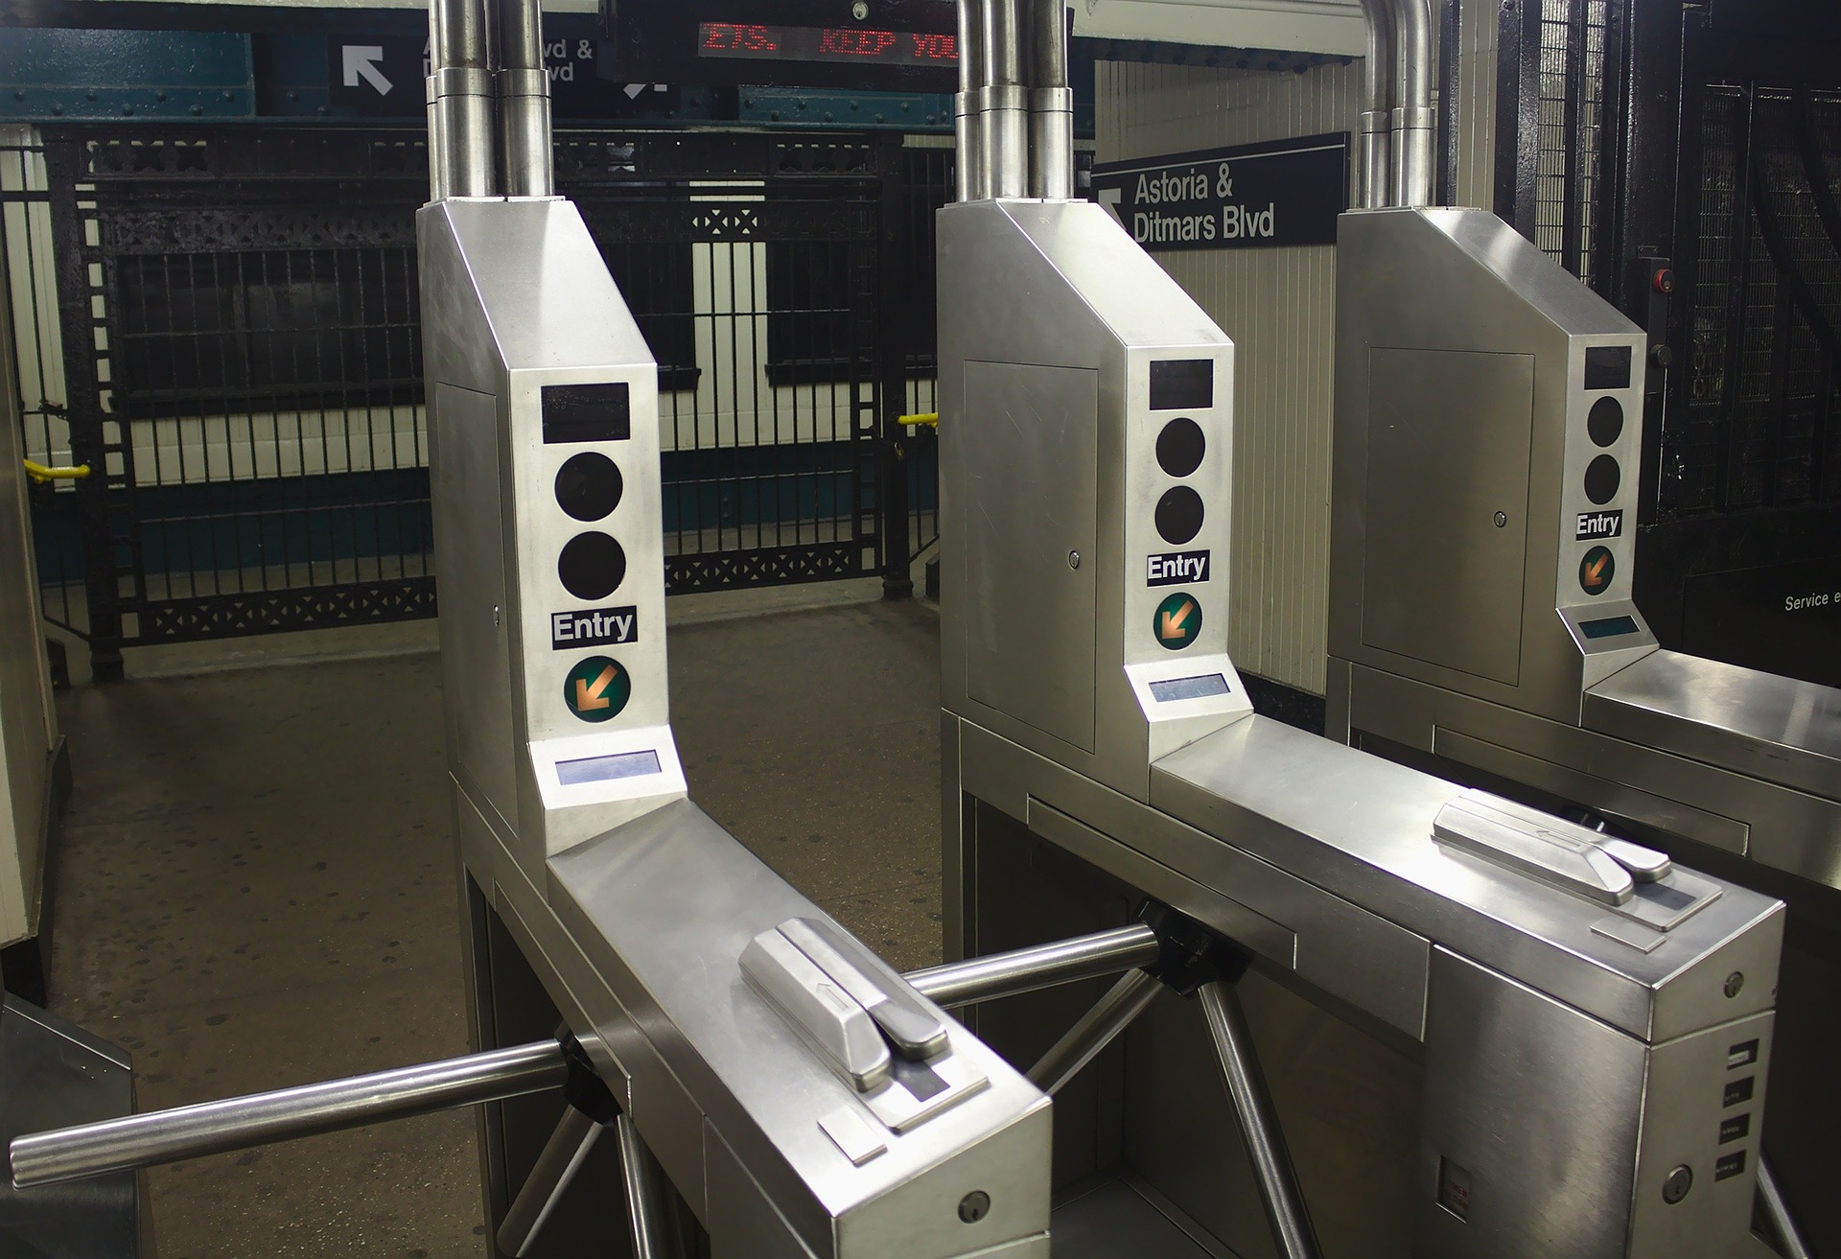
Summary
WomenTechWomenYes(WTWY) is throwing its annual gala this summer
Street teams will collect emails to send out tickets for the gala.
WTWY wants to target, identify and capture potential major donors

Slide 3
How do we target, identify, and capture potential major donors?

Slide 4
Subway Stations
Commuters
Identify high traffic stations (entries and exits)
Days and times
Working individuals
Work week only
Diminish the effect of tourists
Income
Alternative Data
Focus on households >$200k year
Relative presence of tech hubs
Relative presence of Corporate offices

Slide 5
MTA Turnstiles
Historical MTA turnstile data from June 2018 to June 2019
Google Maps API was used to pair stations with zip codes
KEY DATA SOURCES
American Community Survey (ACS)
Accessed ACS data from 2017 to identify zip codes with high:
Households commuting to work by public transportation
Households with income>$200k

Slide 6
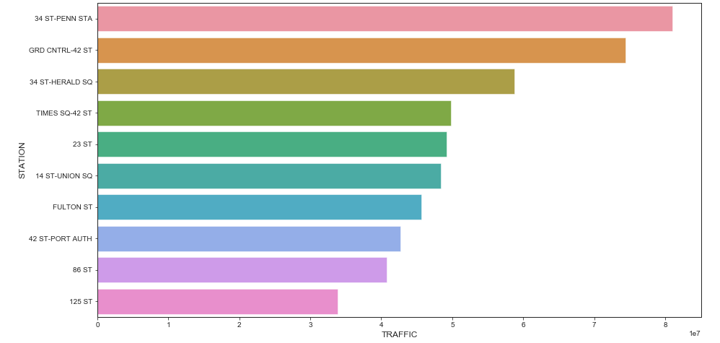
Let’s play first with the MTA Turnstiles data : Top 10 stations by traffic
Top 10 stations by traffic (June 2018-2019, units: 10 mn people)*
Raw Data Source: Metropolitan Transportation Authority
* Only including weekdays

Slide 7
This is cool, but what if we include some demographics into the analysis?

Slide 8
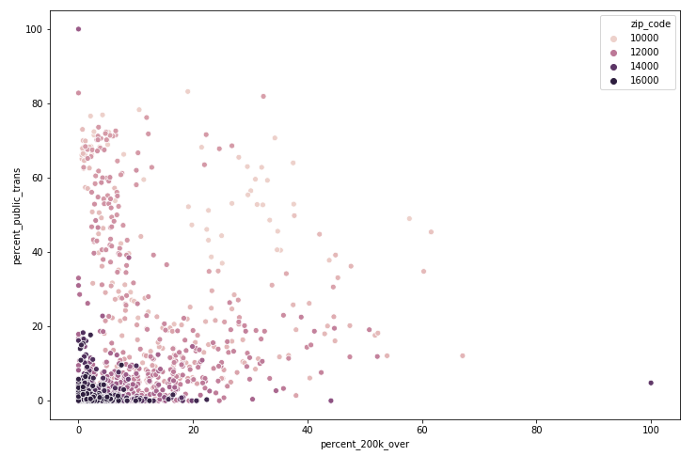
ACS Data: We want zip codes with high incomes and commuters by public transportation
Households with income >200 vs public transportation commuters for NYC zip codes (2017, units: %)
Raw Data Source: American Community Survey

Slide 9
To find the station with the best combination between traffic, income, and commuters a scorecard was created

Slide 10
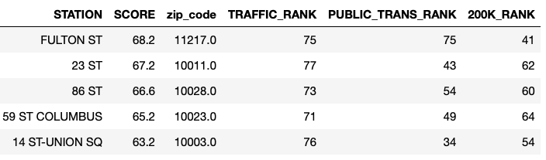
A point ranking system (scorecard) with different weights for the attributes was used to find the top 5 stations
The higher the rank the better the station is positioned in comparison with others for every attribute
The score column is the weighted average of the ranks (points) for traffic, income and commute columns
More attractive
Less attractive
Raw Data Source: Metropolitan Transportation Authority and American Community Survey

Slide 11
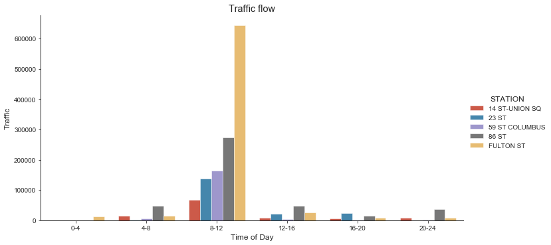
Now we have the top locations let’s find the best time frames
Traffic by time of the day (June 2018-2019, units: people, 24-hour clock)*
Raw Data Source: Metropolitan Transportation Authority
*Excluding weekends

Slide 12
The top 5 stations have a favorable ratio of traffic, income and commuters

Slide 13
FULTON ST
23 ST
86 ST
59 ST
COLUMBUS
14 ST-UNION SQ
10038
Large office buildings and shopping space
Top 10 in traffic
Top 10 in commuters
10011
Large office buildings, universities and hospitals
Top 5 in traffic
High incomes
10028
Wealthy neighborhood
Top 10 in traffic
High incomes
10023
Large office buildings and universities
Top 10 in traffic
High incomes
10003
Corporate offices from large tech (Google, FB, etc.)
Top 5 in traffic

Slide 14
Key Takeaways
The stations with the highest traffic have transfers to different lines
Stations such as the 23rd Street have connection to different MTA lines and also to buses, which guarantee a high traffic to capture emails
Time frames during commute periods are the best to increase reach
The morning period (8am -12pm) is the best time to capture emails, followed by the 12-8pm period
The expansion of data to cover multiple years could help to improve analysis
To reduce the effect of outliers and special events
Expanding street teams outside subway stations can improve target accuracy
Not everybody commute to work using the train, adding street teams outside train stations in trendy neighborhoods could increase reach

Slide 15
Duc Vu https://github.com/dvu4
Elvis Davalillo https://github.com/elvisdavalillo
Farhan Syed
https://github.com/farsyd

Slide 16
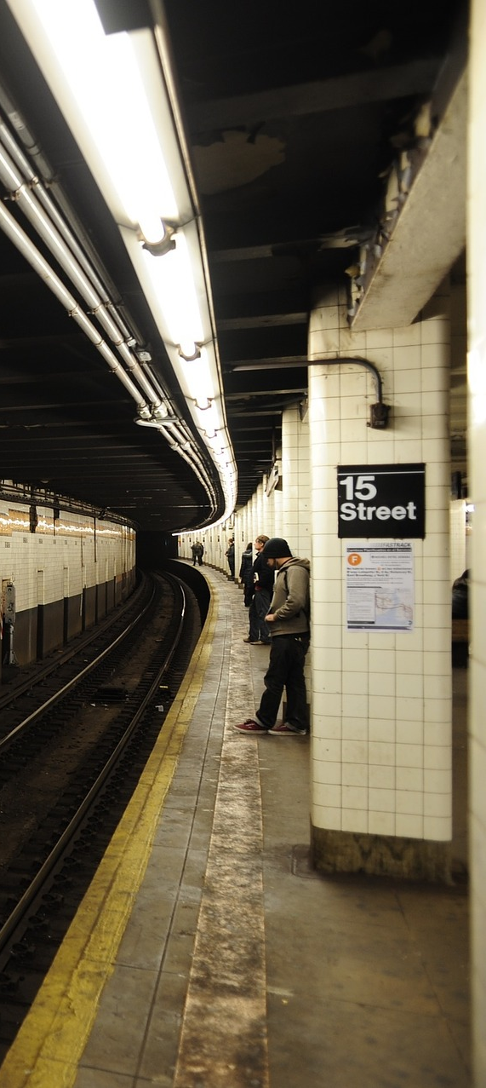
Background
Data Wrangling
EDA
Recommendations
Key Takeaways
Appendix

Slide 17
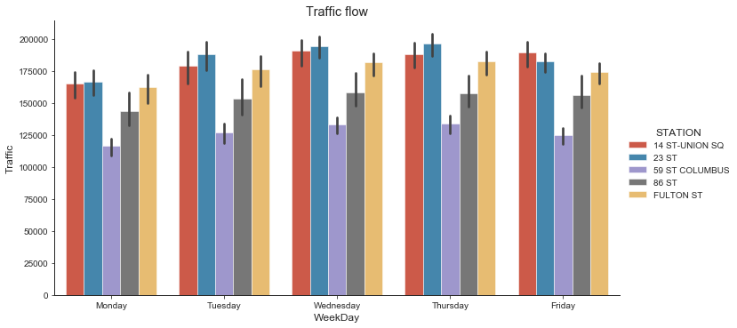
Wednesdays and Thursdays tend to have a slightly higher traffic than the rest of the days
Traffic by weekday for top 5 stations (June 2018-2019, units: people, weekday)*
Raw Data Source: Metropolitan Transportation Authority
*Excluding weekends

Slide 18
Inconsistent turnstile data
Missing zip codes
Null values
Replace negative entries and exits rates with zero.
Label differences in total traffic greater than 80,000 per turnstile per day.
Modified existing code for Google Maps API
Searched using station names from turnstile data
Missing commuter data was assumed to be zero
Rows with missing incomes where removed from the survey data

